Slide 1
Monetary Bulletin 2011/4
Powerpoint charts from Economic and monetary developments and prospects

Slide 2
I Economic outlook and main uncertainties

Slide 3
I Economic outlook and main uncertainties

Slide 4
I Economic outlook and main uncertainties

Slide 5
I Economic outlook and main uncertainties

Slide 6
I Economic outlook and main uncertainties

Slide 7
I Economic outlook and main uncertainties

Slide 8
I Economic outlook and main uncertainties

Slide 9
I Economic outlook and main uncertainties

Slide 10
I Economic outlook and main uncertainties

Slide 11
I Economic outlook and main uncertainties

Slide 12
I Economic outlook and main uncertainties

Slide 13
I Economic outlook and main uncertainties

Slide 14
I Economic outlook and main uncertainties

Slide 15
I Economic outlook and main uncertainties

Slide 16
I Economic outlook and main uncertainties

Slide 17
I Economic outlook and main uncertainties

Slide 18
I Economic outlook and main uncertainties

Slide 19
II External conditions and exports

Slide 20
II External conditions and exports

Slide 21
II External conditions and exports

Slide 22
II External conditions and exports

Slide 23
II External conditions and exports

Slide 24
II External conditions and exports

Slide 25
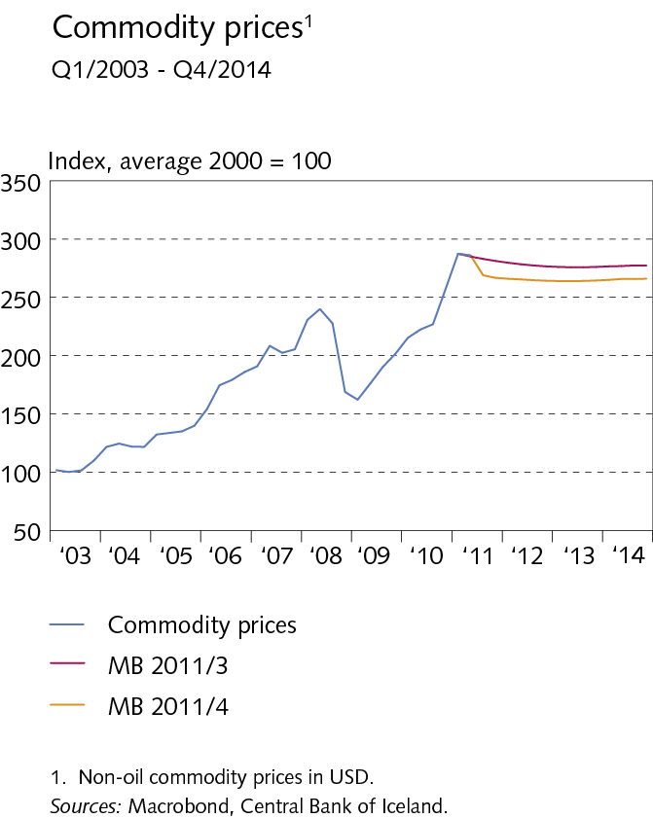
II External conditions and exports

Slide 26
II External conditions and exports

Slide 27
II External conditions and exports

Slide 28
II External conditions and exports

Slide 29
II External conditions and exports

Slide 30
II External conditions and exports

Slide 31
III Financial conditions

Slide 32
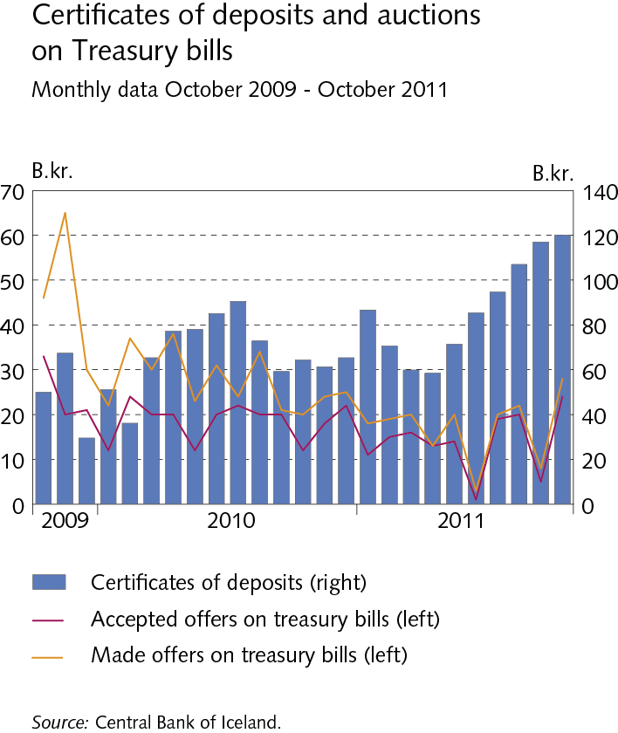
III Financial conditions

Slide 33
III Financial conditions

Slide 34
III Financial conditions

Slide 35
III Financial conditions

Slide 36
III Financial conditions

Slide 37
III Financial conditions

Slide 38
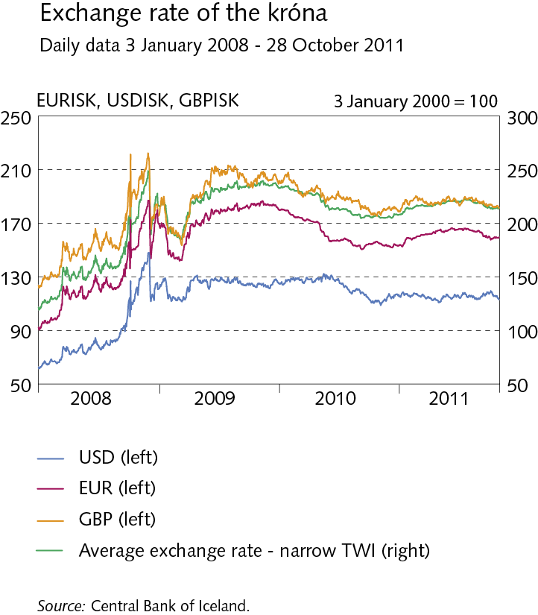
III Financial conditions

Slide 39
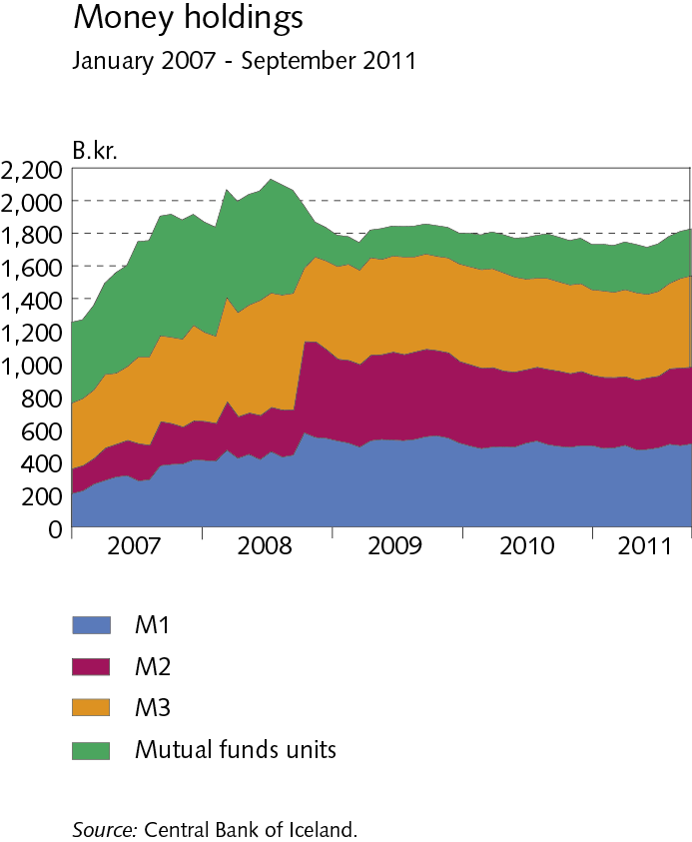
III Financial conditions

Slide 40
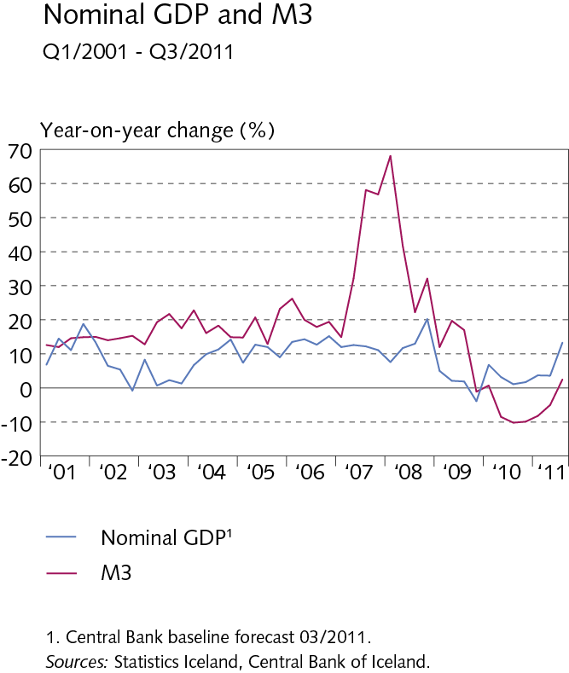
III Financial conditions

Slide 41
III Financial conditions

Slide 42
III Financial conditions

Slide 43
III Financial conditions

Slide 44
IV Domestic demand and production

Slide 45
IV Domestic demand and production

Slide 46
IV Domestic demand and production

Slide 47
IV Domestic demand and production

Slide 48
IV Domestic demand and production

Slide 49
IV Domestic demand and production

Slide 50
IV Domestic demand and production

Slide 51
IV Domestic demand and production

Slide 52
IV Domestic demand and production

Slide 53
IV Domestic demand and production

Slide 54
IV Domestic demand and production

Slide 55
IV Domestic demand and production

Slide 56
IV Domestic demand and production

Slide 57
IV Domestic demand and production

Slide 58
IV Domestic demand and production

Slide 59
IV Domestic demand and production

Slide 60
IV Domestic demand and production

Slide 61
IV Domestic demand and production

Slide 62
IV Domestic demand and production

Slide 63
Box IV-1

Slide 64
V Public sector finances

Slide 65
V Public sector finances

Slide 66
V Public sector finances

Slide 67
V Public sector finances

Slide 68
V Public sector finances

Slide 69
V Public sector finances

Slide 70
V Public sector finances

Slide 71
VI Labour market and wage developments

Slide 72
VI Labour market and wage developments

Slide 73
VI Labour market and wage developments

Slide 74
VI Labour market and wage developments

Slide 75
VI Labour market and wage developments

Slide 76
VI Labour market and wage developments

Slide 77
VI Labour market and wage developments

Slide 78
VI Labour market and wage developments

Slide 79
VI Labour market and wage developments

Slide 80
Box VI-1

Slide 81
Box VI-1

Slide 82
Box VI-2

Slide 83
VII External conditions

Slide 84
VII External conditions

Slide 85
VII External conditions

Slide 86
VII External conditions

Slide 87
VII External conditions

Slide 88
VII External conditions

Slide 89
VIII Price developments and inflation target

Slide 90
VIII Price developments and inflation target

Slide 91
VIII Price developments and inflation target

Slide 92
VIII Price developments and inflation target

Slide 93
VIII Price developments and inflation target

Slide 94
VIII Price developments and inflation target

Slide 95
VIII Price developments and inflation target

Slide 96
VIII Price developments and inflation target

Slide 97
VIII Price developments and inflation target

Slide 98
VIII Price developments and inflation target

Slide 99
VIII Price developments and inflation target

Slide 100
Appendix 2

Slide 101
Appendix 2

Slide 102
Appendix 2

Slide 103
Appendix 2

Slide 104
Appendix 2

Slide 105
Appendix 2

