Slide 1
Monetary Bulletin 2011/4
Powerpoint charts from Tables and charts

Slide 2
Tables and charts

Slide 3
Tables and charts

Slide 4
Tables and charts

Slide 5
Tables and charts

Slide 6
Tables and charts

Slide 7
Tables and charts

Slide 8
Tables and charts

Slide 9
Tables and charts

Slide 10
Tables and charts

Slide 11
Tables and charts

Slide 12
Tables and charts

Slide 13
Tables and charts

Slide 14
Tables and charts

Slide 15
Tables and charts

Slide 16
Tables and charts

Slide 17
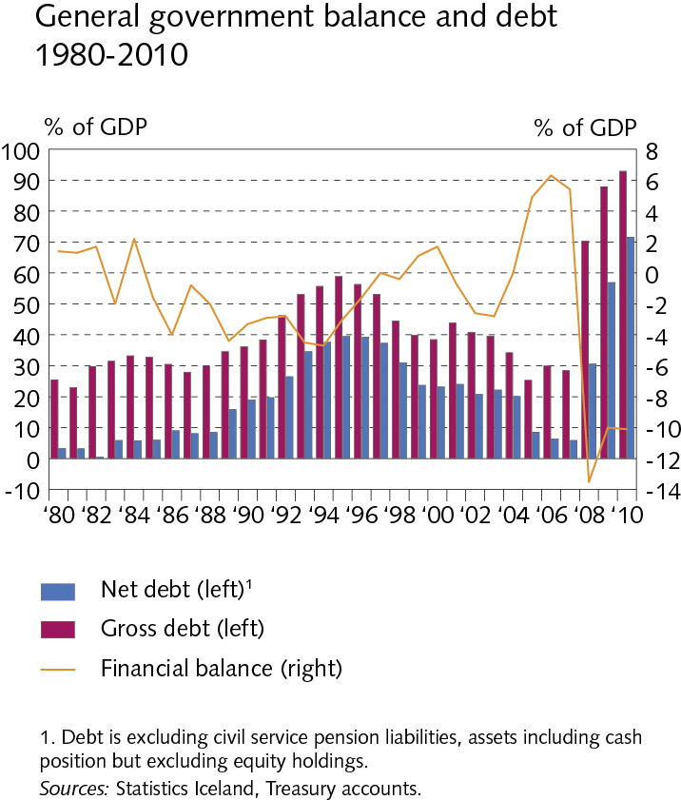
Tables and charts

Slide 18
Tables and charts

Slide 19
Tables and charts

Slide 20
Tables and charts

Slide 21
Tables and charts

Slide 22
Tables and charts

Slide 23
Tables and charts

Slide 24
Tables and charts

Slide 25
Tables and charts

Slide 26
Tables and charts

Slide 27
Tables and charts

Slide 28
Tables and charts

