Slide 1
Monetary Bulletin 2011/2
Powerpoint charts from Economic and monetary developments and prospects

Slide 2
I Economic outlook and main uncertainties

Slide 3
I Economic outlook and main uncertainties

Slide 4
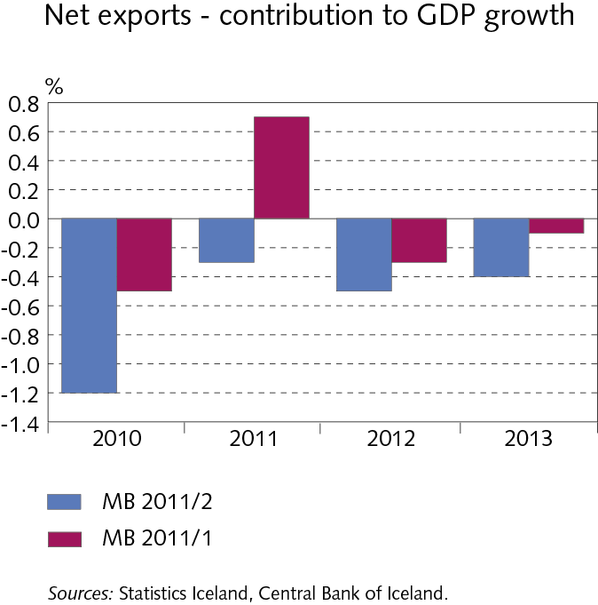
I Economic outlook and main uncertainties

Slide 5
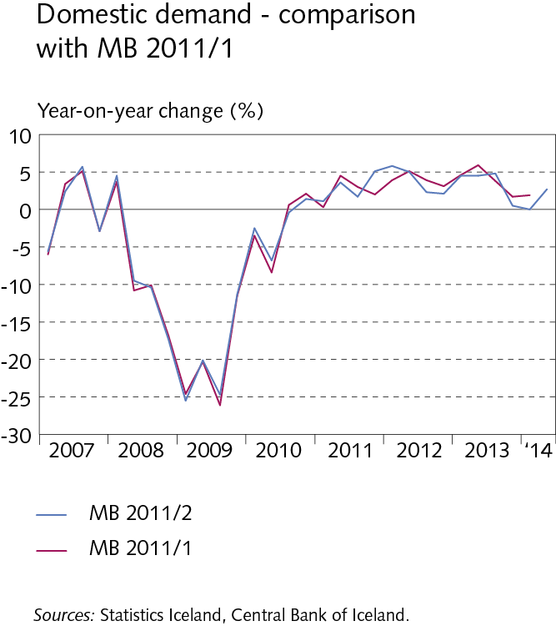
I Economic outlook and main uncertainties

Slide 6
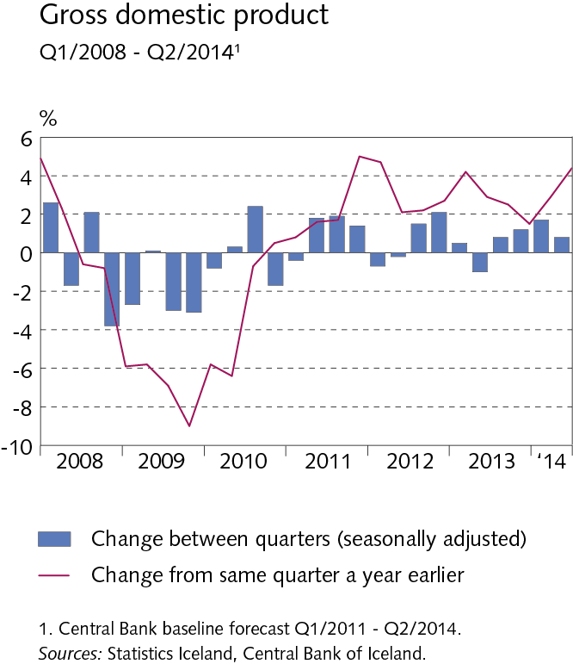
I Economic outlook and main uncertainties

Slide 7
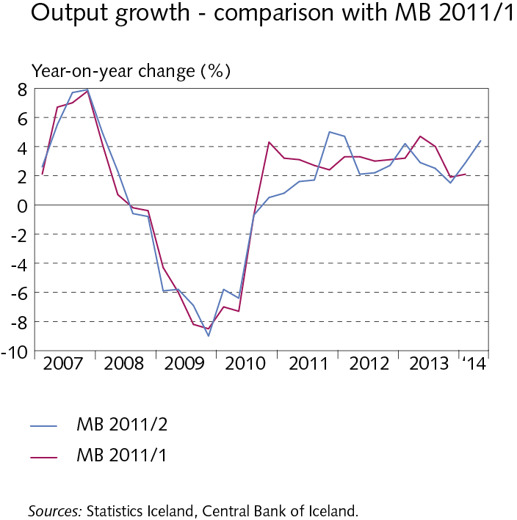
I Economic outlook and main uncertainties

Slide 8
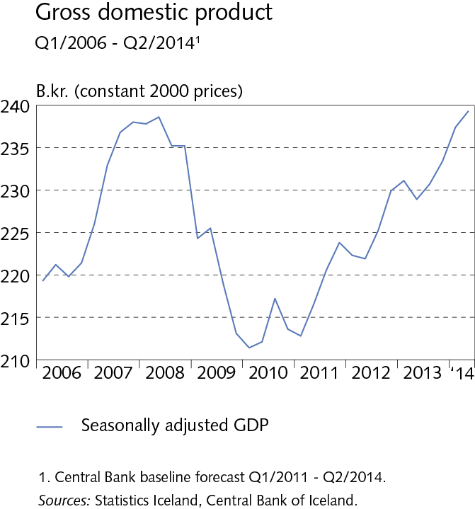
I Economic outlook and main uncertainties

Slide 9
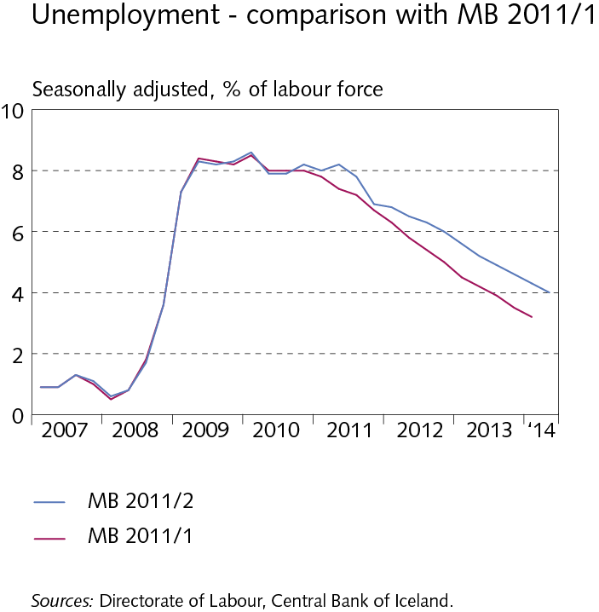
I Economic outlook and main uncertainties

Slide 10
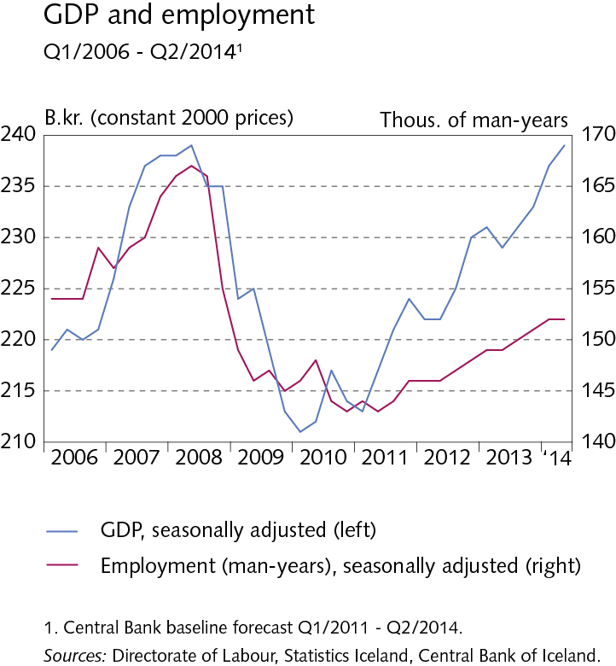
I Economic outlook and main uncertainties

Slide 11
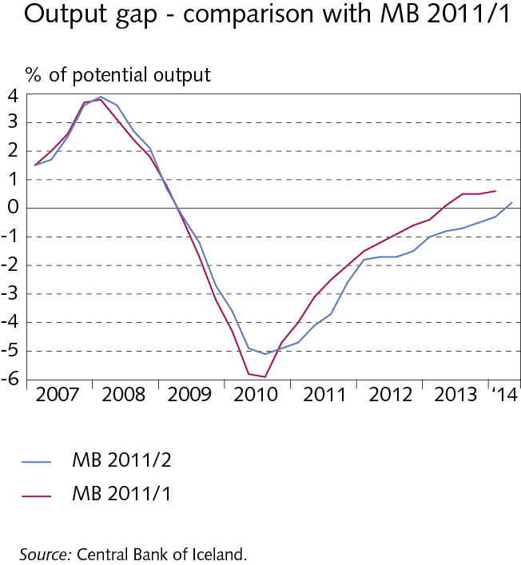
I Economic outlook and main uncertainties

Slide 12
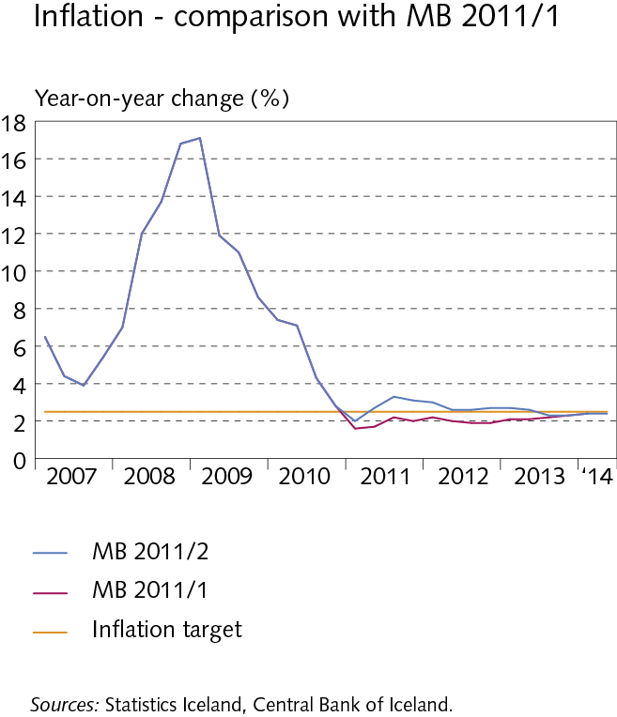
I Economic outlook and main uncertainties

Slide 13
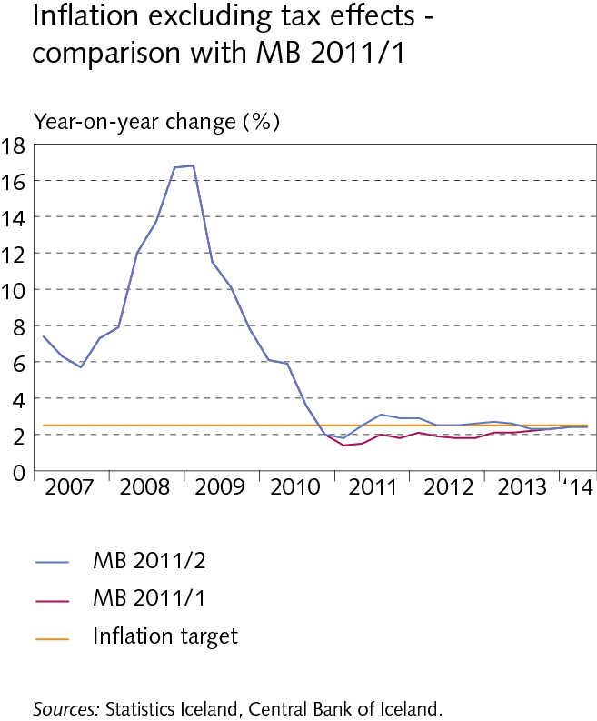
I Economic outlook and main uncertainties

Slide 14
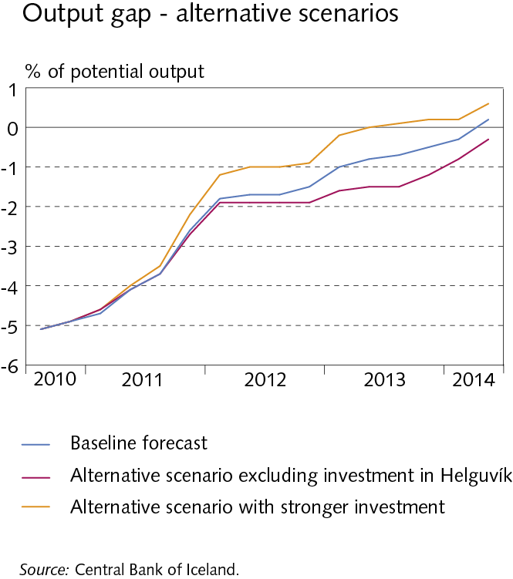
I Economic outlook and main uncertainties

Slide 15
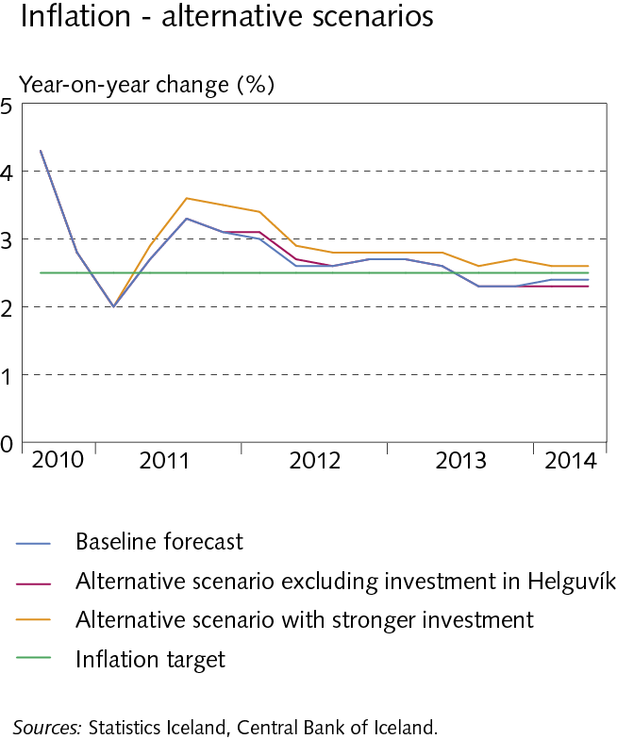
I Economic outlook and main uncertainties

Slide 16
II External conditions and exports

Slide 17
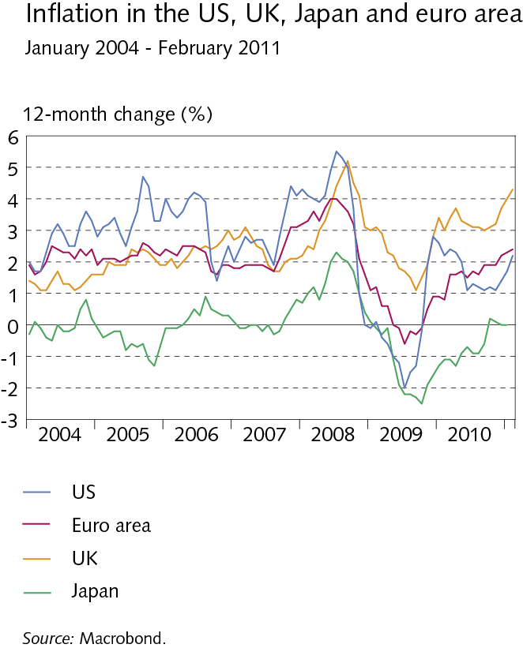
II External conditions and exports

Slide 18
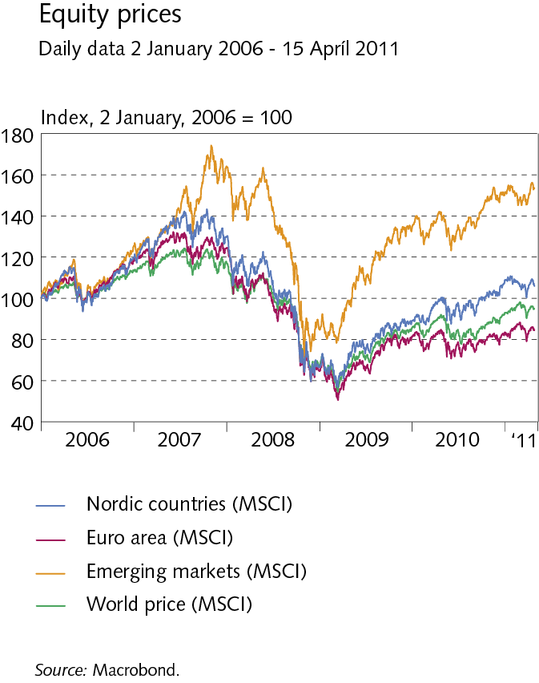
II External conditions and exports

Slide 19
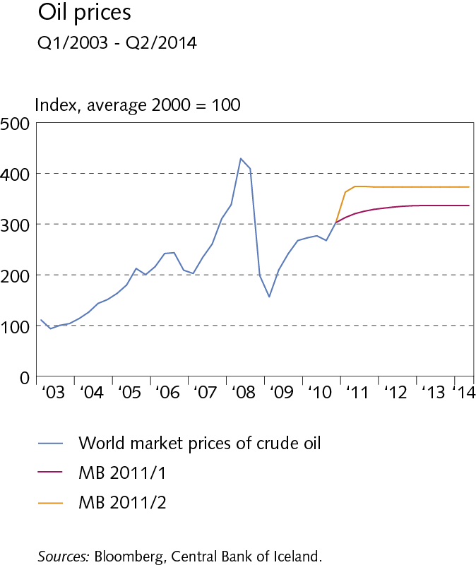
II External conditions and exports

Slide 20
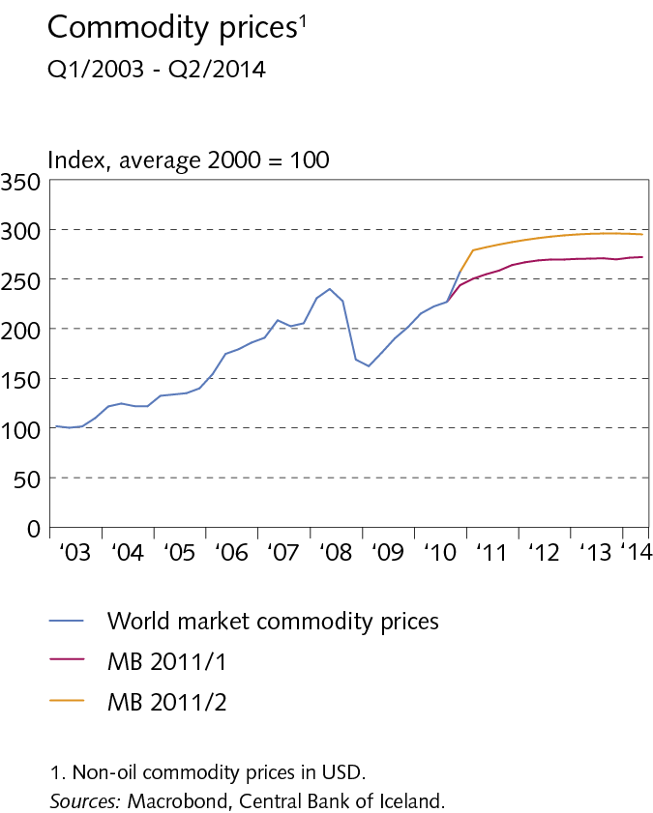
II External conditions and exports

Slide 21
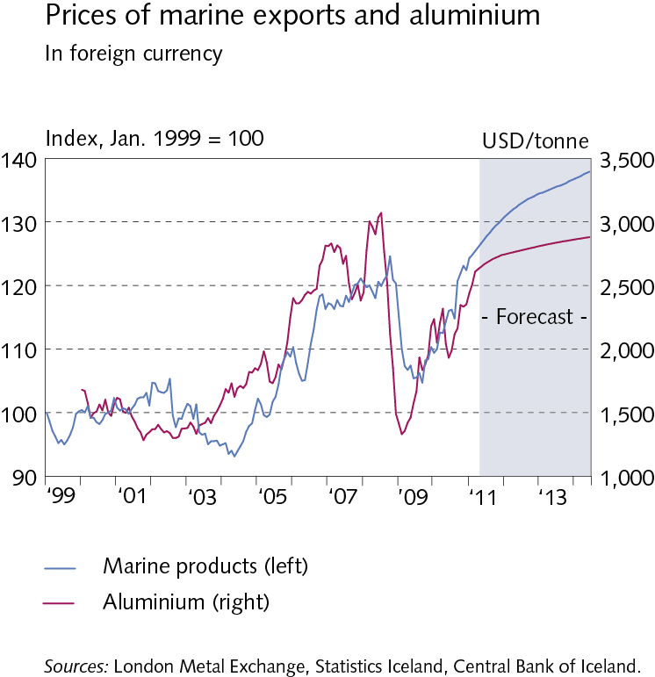
II External conditions and exports

Slide 22
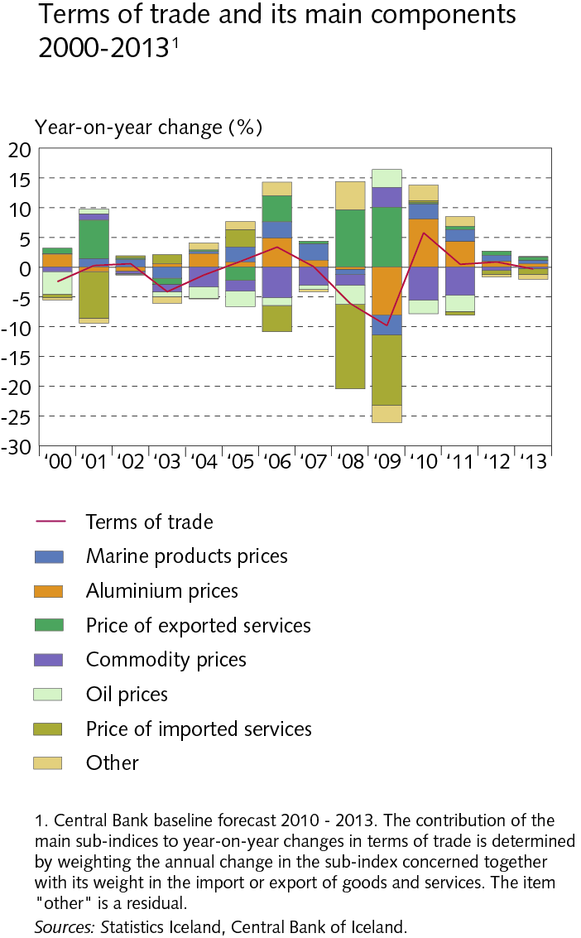
II External conditions and exports

Slide 23
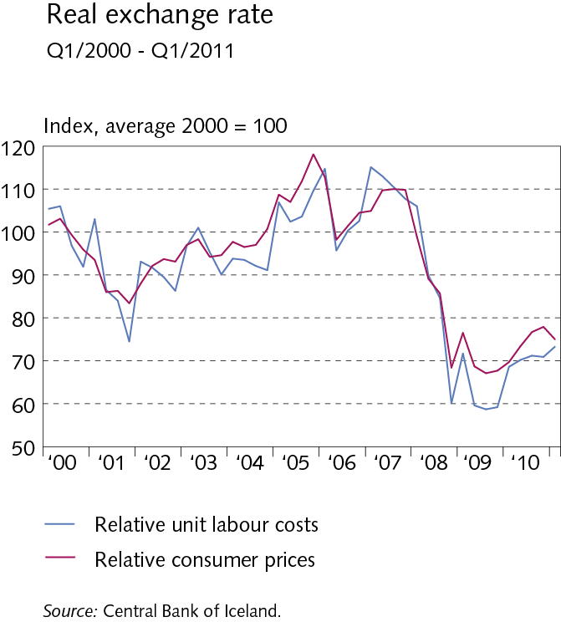
II External conditions and exports

Slide 24
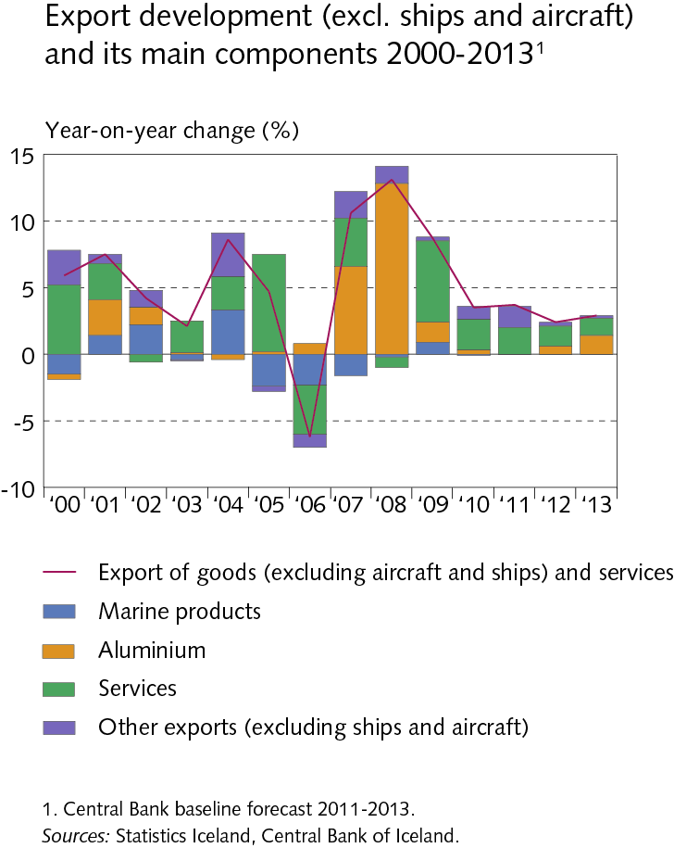
II External conditions and exports

Slide 25
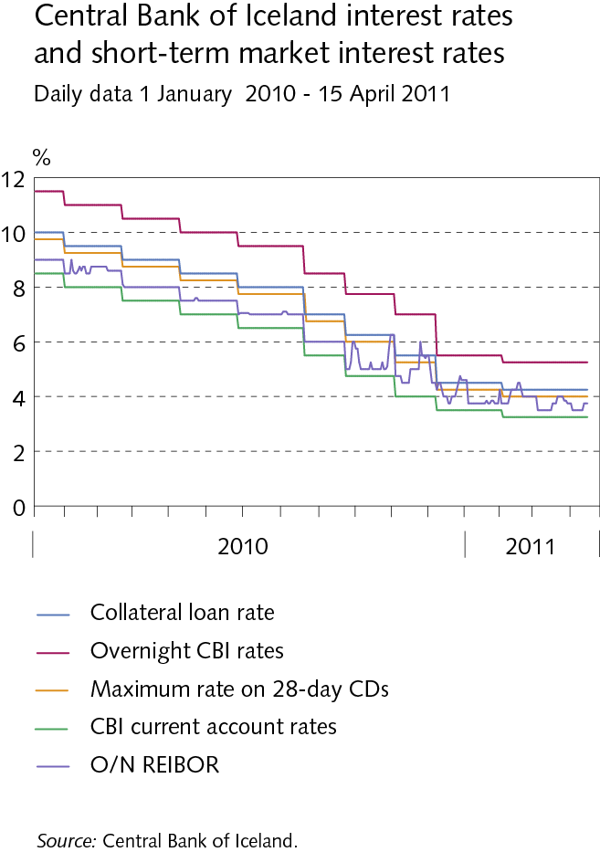
III Financial conditions

Slide 26
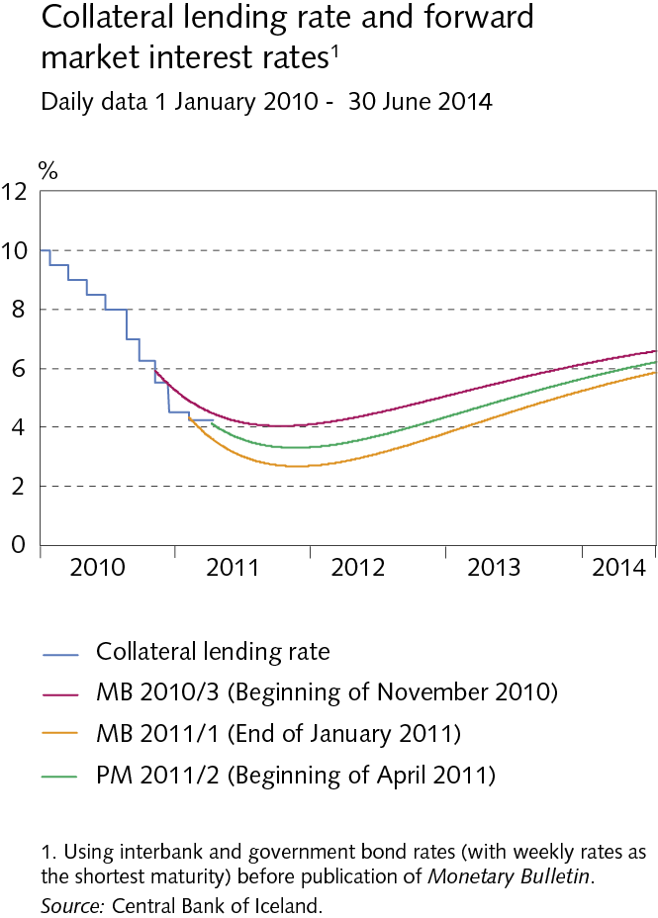
III Financial conditions

Slide 27
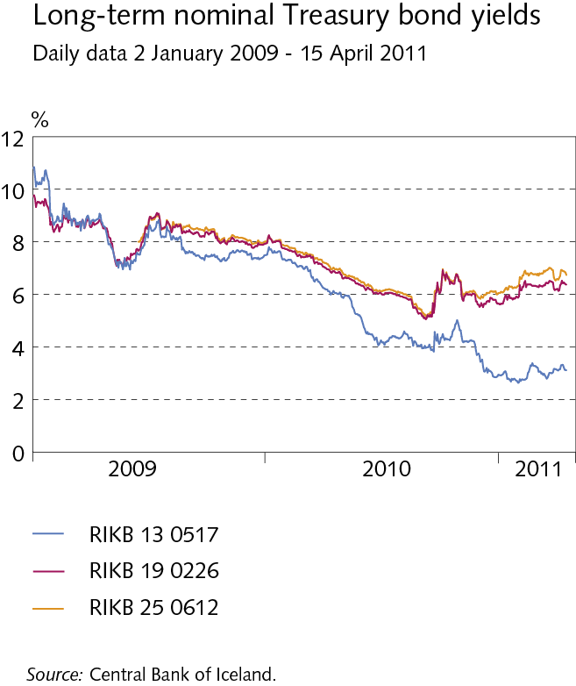
III Financial conditions

Slide 28
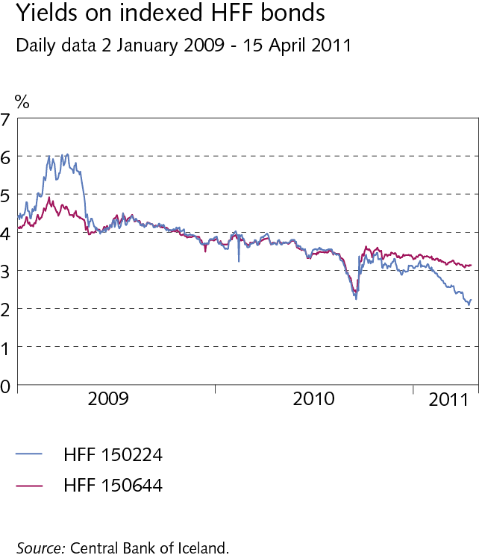
III Financial conditions

Slide 29
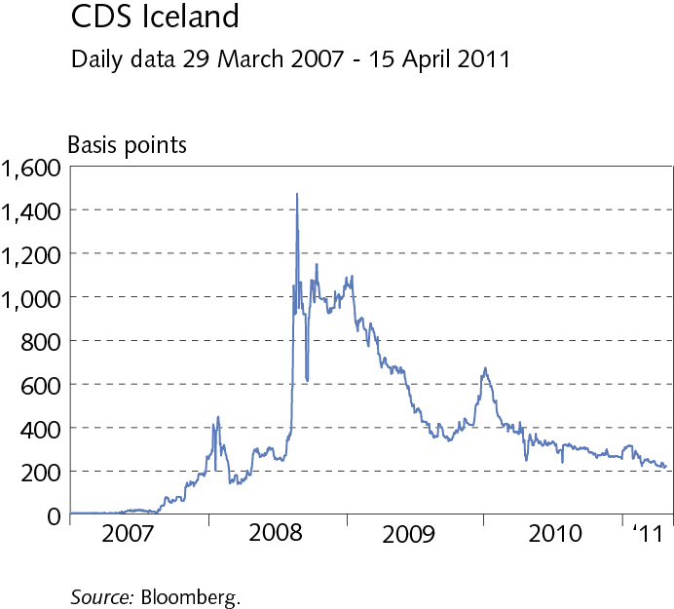
III Financial conditions

Slide 30
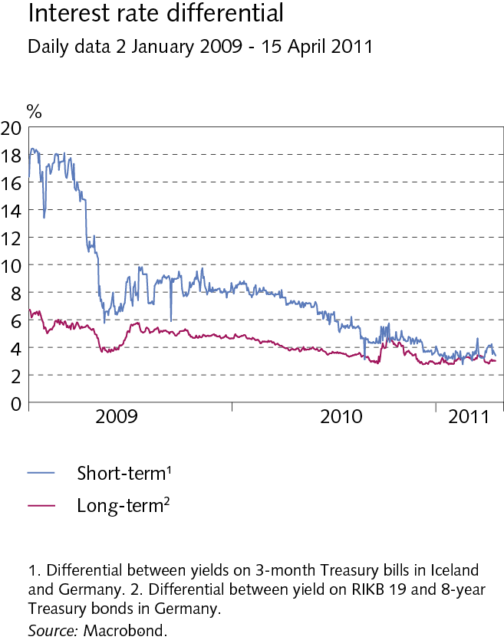
III Financial conditions

Slide 31
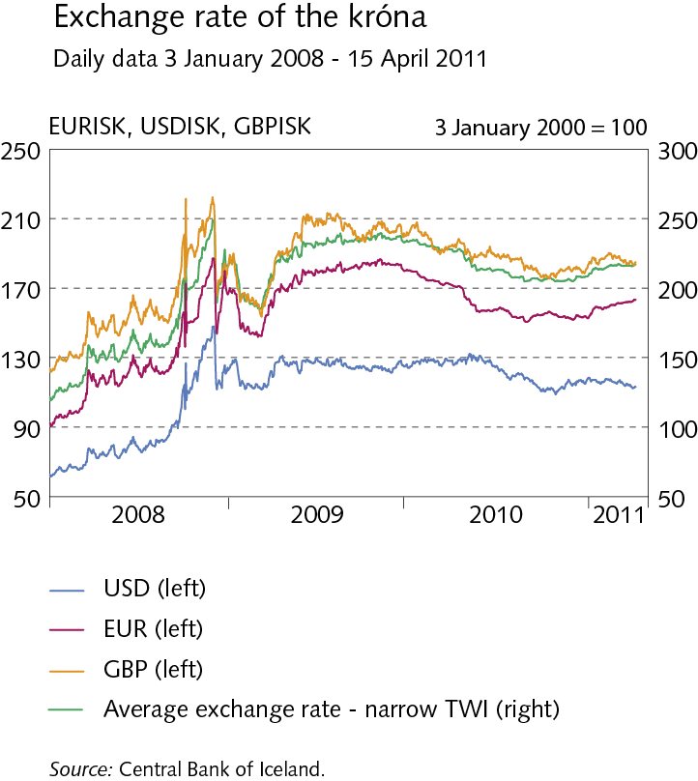
III Financial conditions

Slide 32
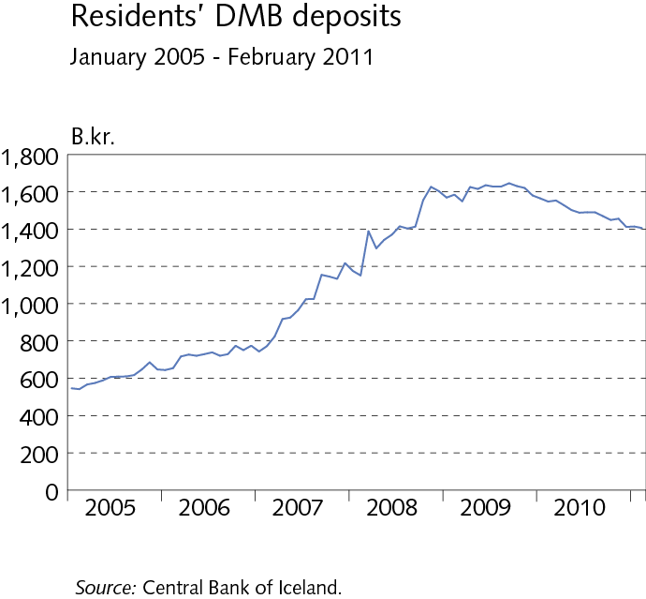
III Financial conditions

Slide 33
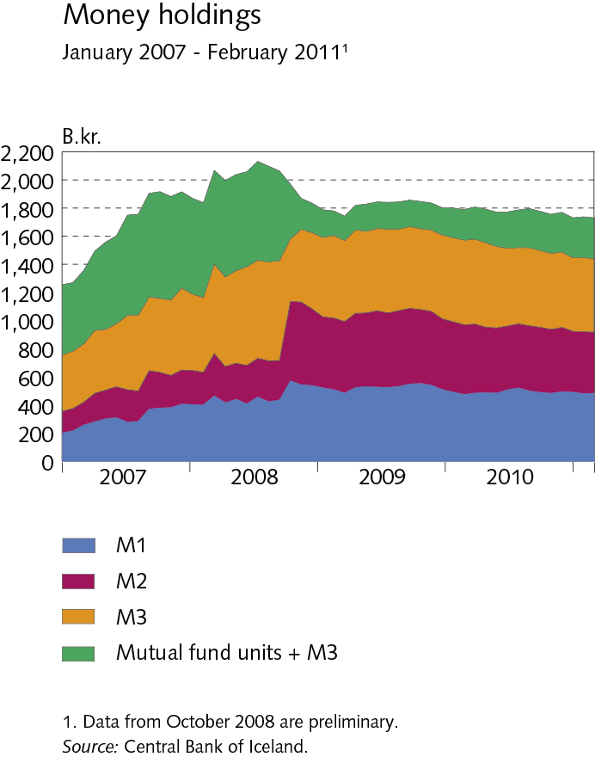
III Financial conditions

Slide 34
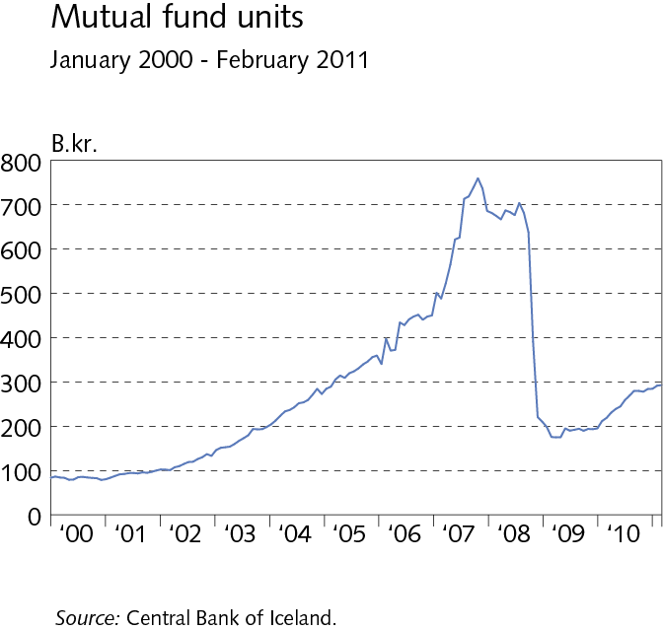
III Financial conditions

Slide 35
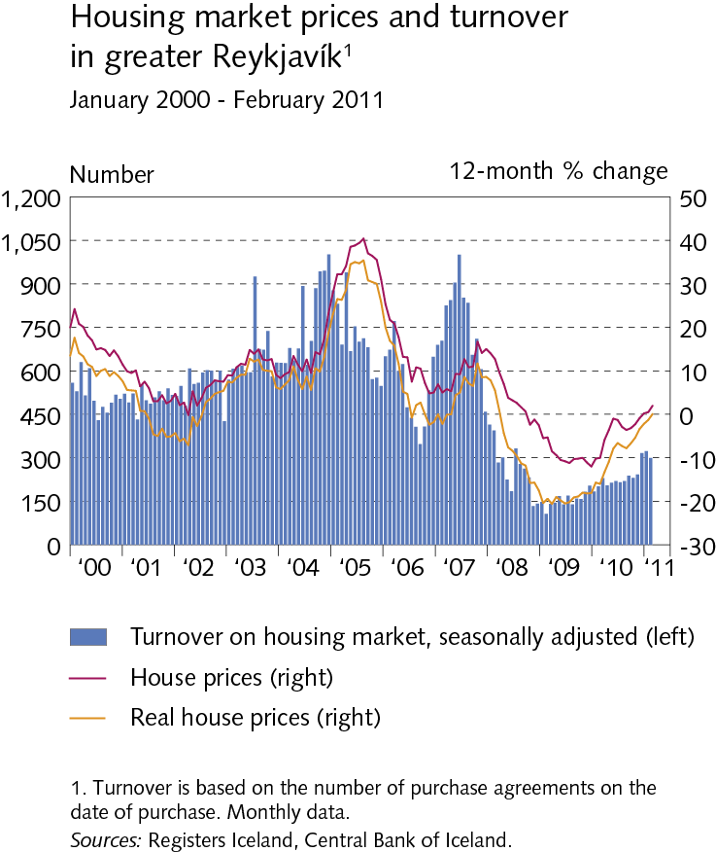
III Financial conditions

Slide 36
III Financial conditions

Slide 37
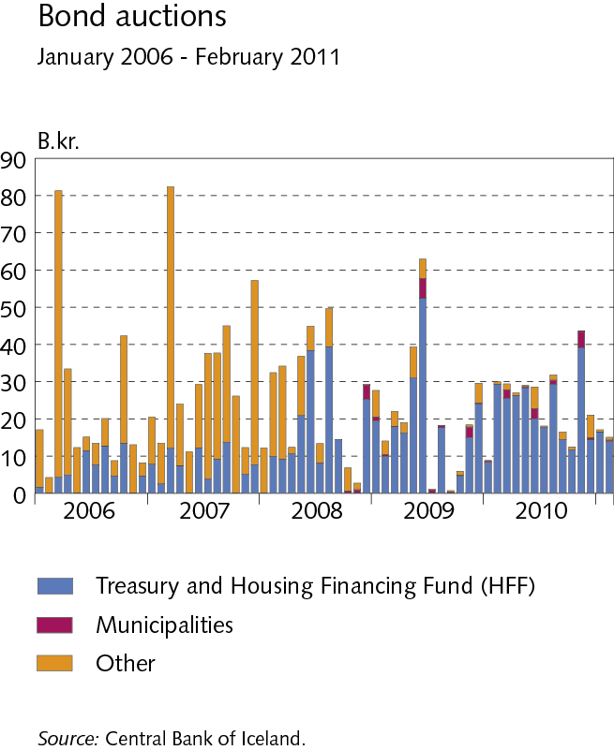
III Financial conditions

Slide 38
III Financial conditions

Slide 39
III Financial conditions

Slide 40
III Financial conditions

Slide 41
III Financial conditions

Slide 42
IV Domestic demand and production

Slide 43
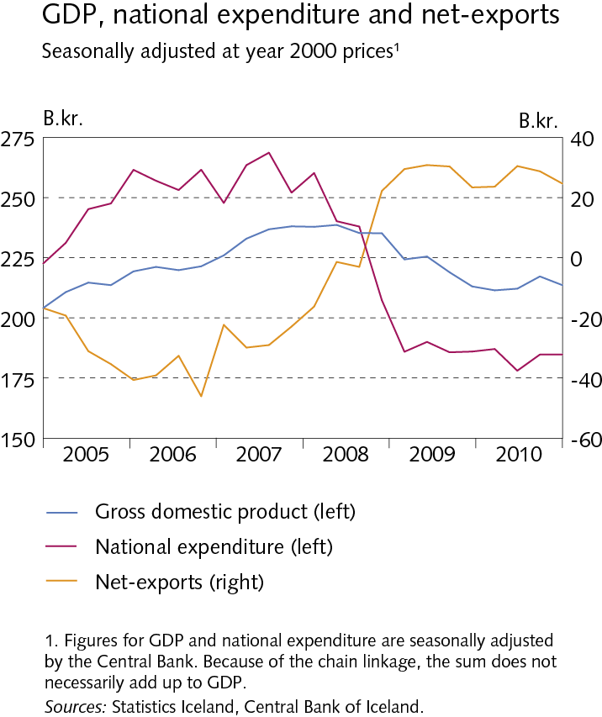
IV Domestic demand and production

Slide 44
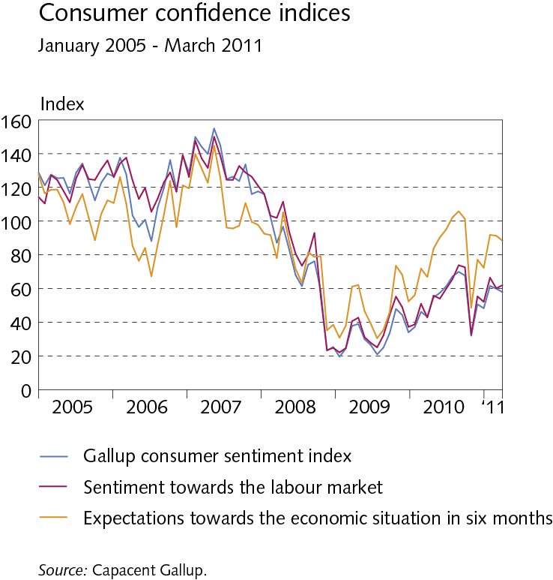
IV Domestic demand and production

Slide 45
IV Domestic demand and production

Slide 46
IV Domestic demand and production

Slide 47
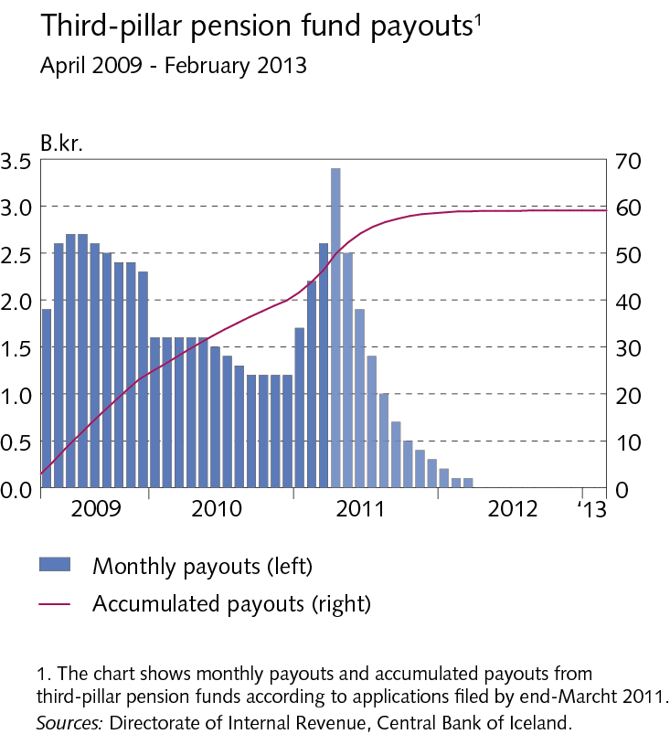
IV Domestic demand and production

Slide 48
IV Domestic demand and production

Slide 49
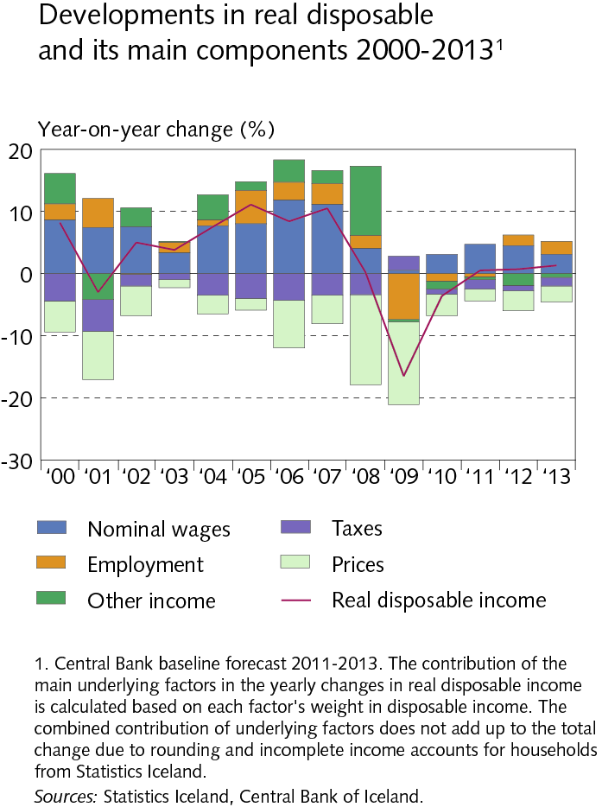
IV Domestic demand and production

Slide 50
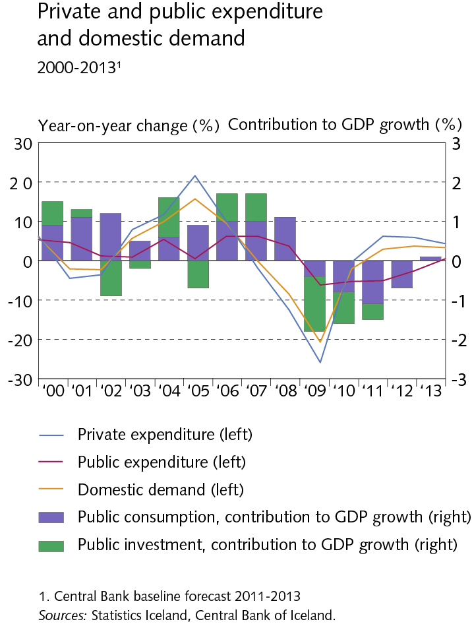
IV Domestic demand and production

Slide 51
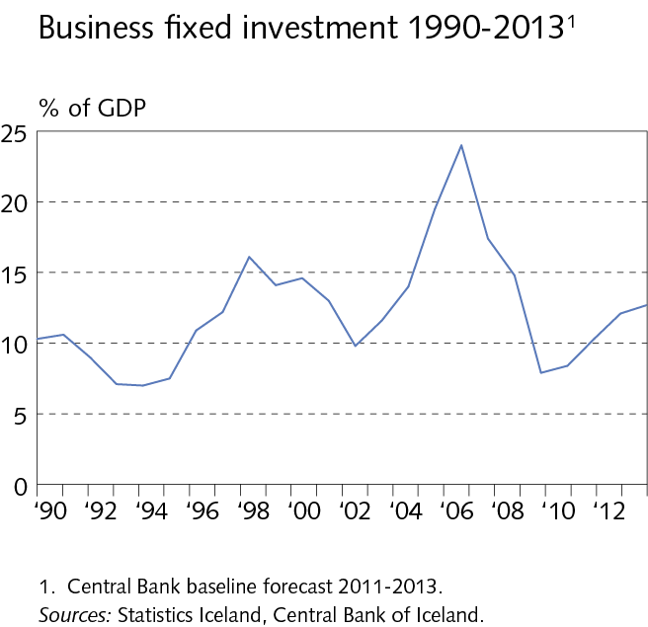
IV Domestic demand and production

Slide 52
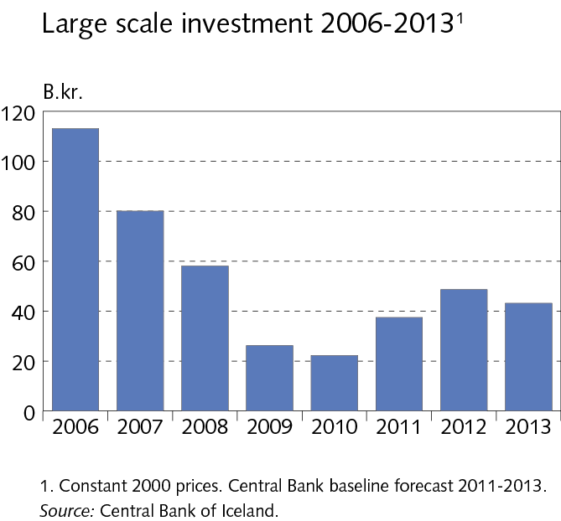
IV Domestic demand and production

Slide 53
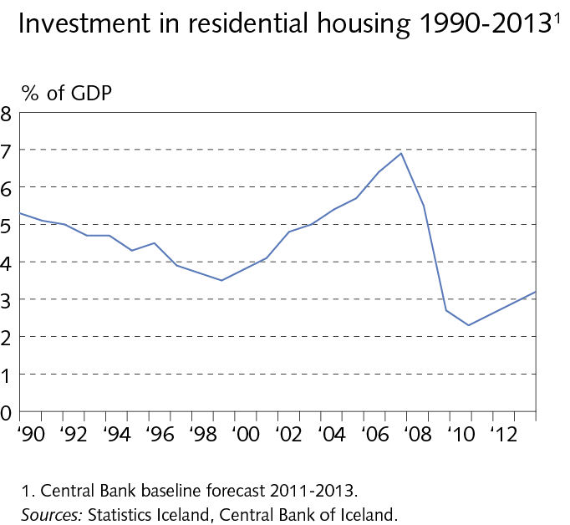
IV Domestic demand and production

Slide 54
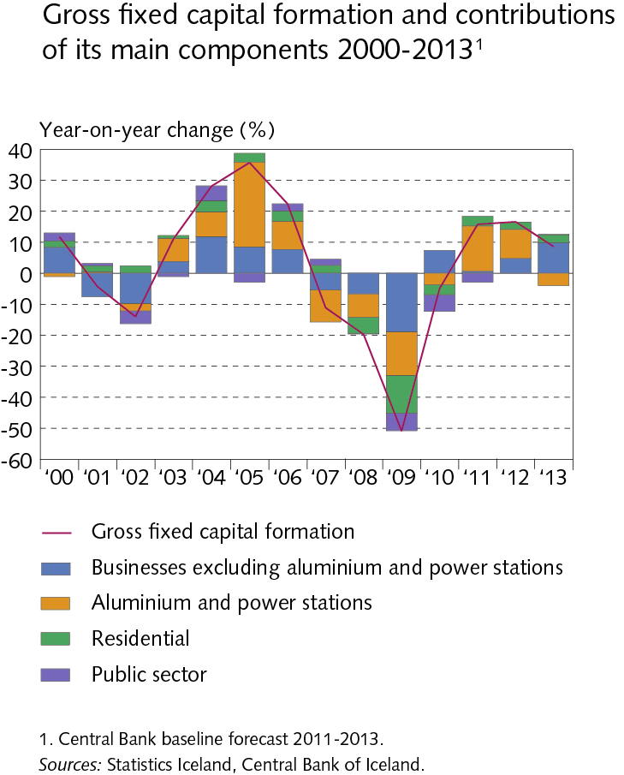
IV Domestic demand and production

Slide 55
IV Domestic demand and production

Slide 56
IV Domestic demand and production

Slide 57
IV Domestic demand and production

Slide 58
IV Domestic demand and production

Slide 59
V Public sector finances

Slide 60
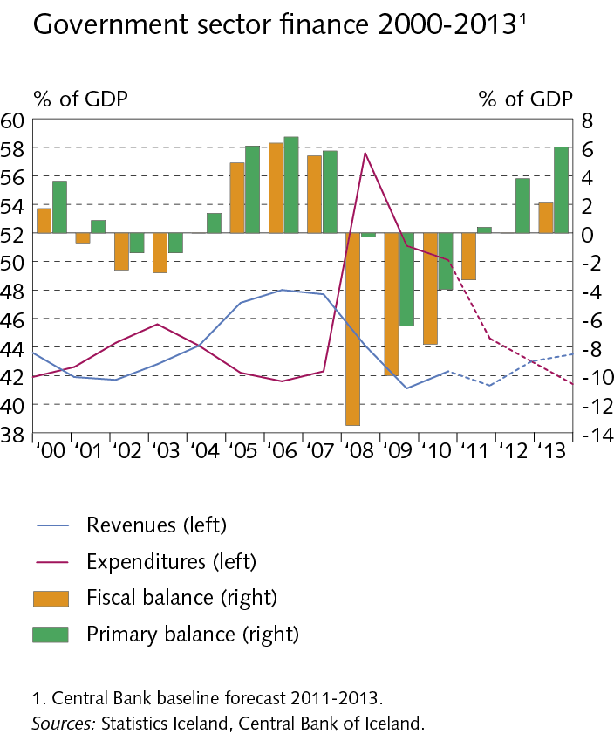
V Public sector finances

Slide 61
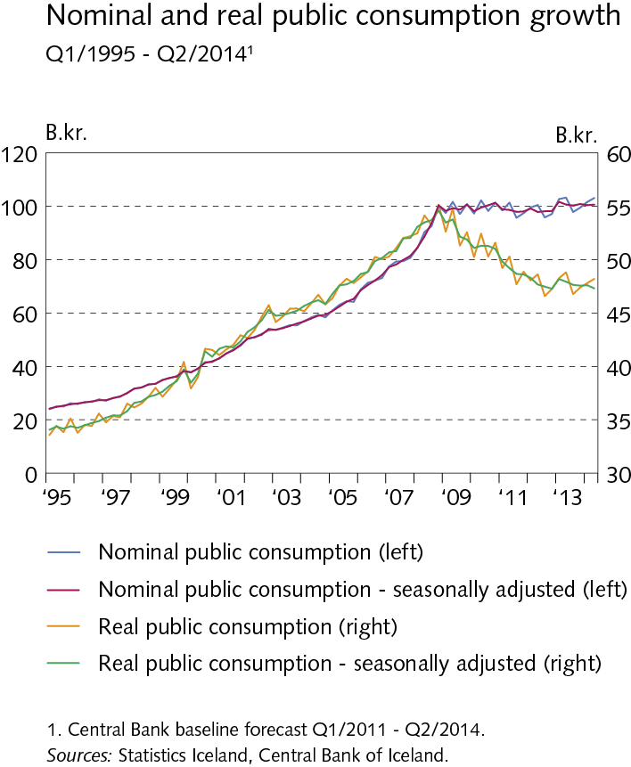
V Public sector finances

Slide 62
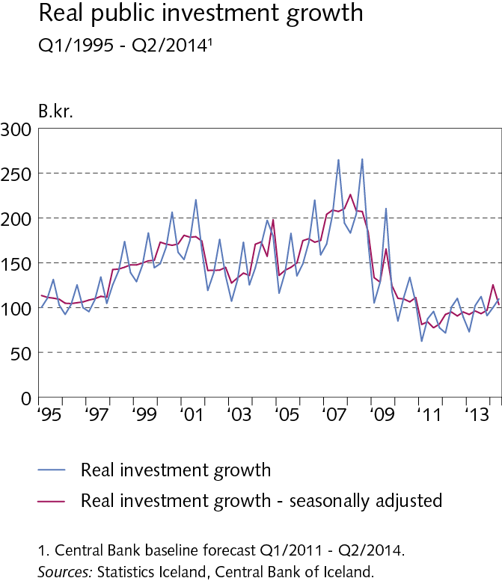
V Public sector finances

Slide 63
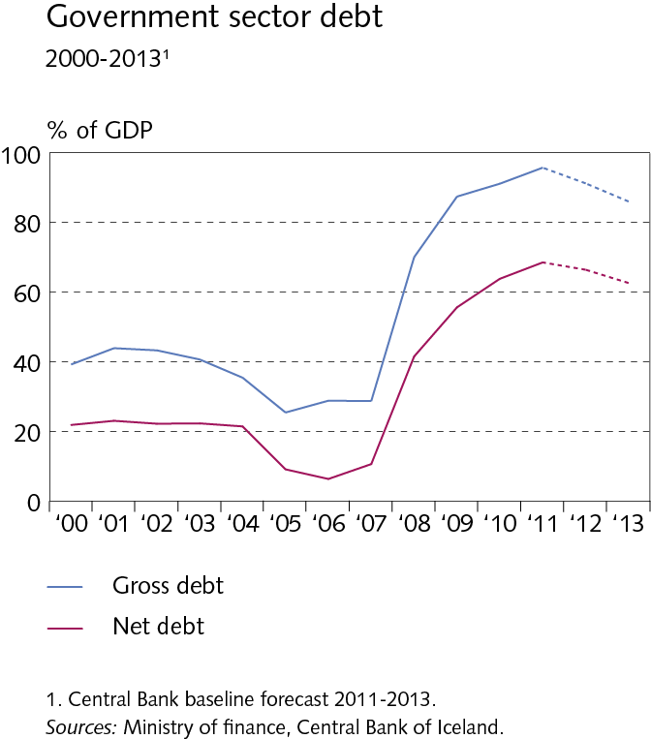
V Public sector finances

Slide 64
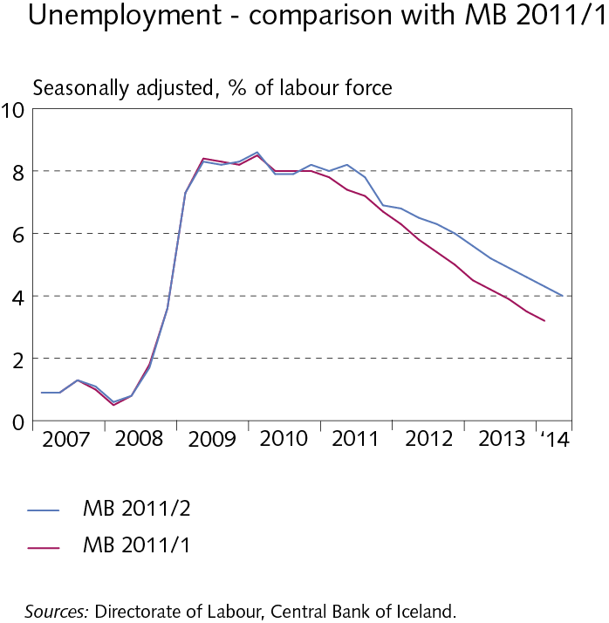
VI Labour market and wage developments

Slide 65
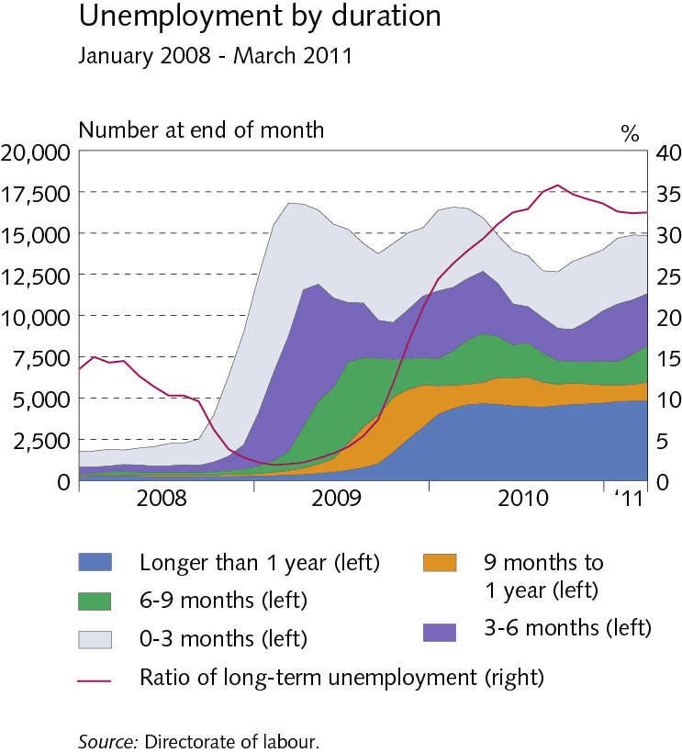
VI Labour market and wage developments

Slide 66
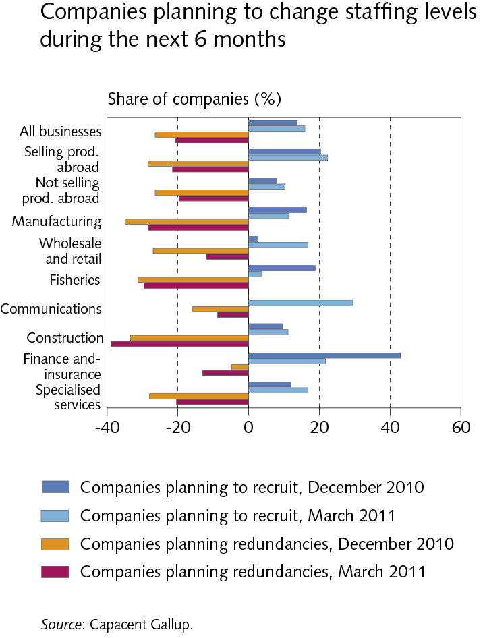
VI Labour market and wage developments

Slide 67
VI Labour market and wage developments

Slide 68
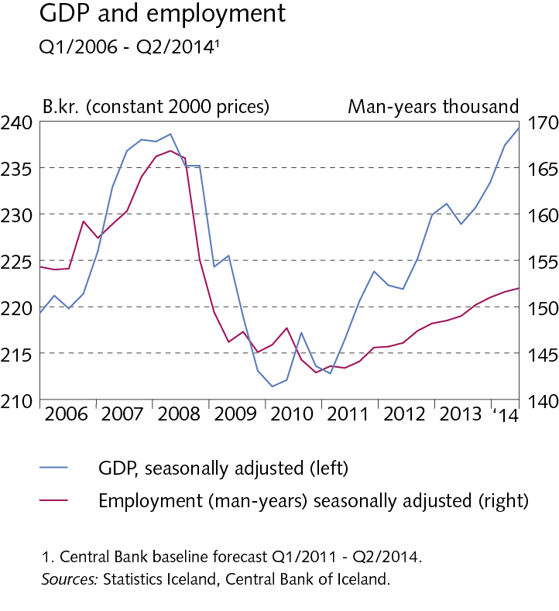
VI Labour market and wage developments

Slide 69
VI Labour market and wage developments

Slide 70
VII External conditions

Slide 71
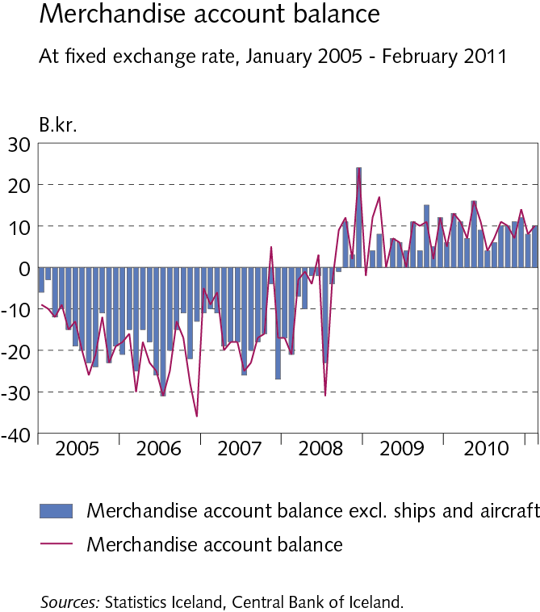
VII External conditions

Slide 72
VII External conditions

Slide 73
VII External conditions

Slide 74
VII External conditions

Slide 75
VIII Price developments and inflation target

Slide 76
VIII Price developments and inflation target

Slide 77
VIII Price developments and inflation target

Slide 78
VIII Price developments and inflation target

Slide 79
VIII Price developments and inflation target

Slide 80
VIII Price developments and inflation target

Slide 81
VIII Price developments and inflation target

Slide 82
VIII Price developments and inflation target

Slide 83
VIII Price developments and inflation target

Slide 84
VIII Price developments and inflation target

Slide 85
VIII Price developments and inflation target

Slide 86
VIII Price developments and inflation target

Slide 87
VIII Price developments and inflation target

